Slide 1
Introduction
Overview of Modern Equity Market Structures

Slide 2
High Frequency Market Microstructure
Markets are different now in fundamental ways
High Frequency Trading and Algorithmic Trading
Markets are fragmented
Think about microstructure research issues in the high frequency world
We need to discuss some of the gaps that arise from the high frequency world
Research must also change to reflect new realities of the high frequency world
To investigate the effects of these changes, we must understand
How to analyze the high frequency data
The today’s market structures

Slide 3
Traditional Finance
Asset Pricing aims to understand what should be the price of a security
It assumes the frictionless market
It does not address how prices adjust to reflect news
????
Asset Price
Asset Value
Trade without costs
Trade immediately
Trade limitless amount

Slide 4
In practice, trading matters
In practice, news and investors’ valuations are incorporated into security prices through trading : Price Discovery Process
Trading rules will affect how asset prices change over time
Financial Markets
Asset Price
Asset Value
Trade with costs
Wait for trading
Unable to trade limitless amounts

Slide 5
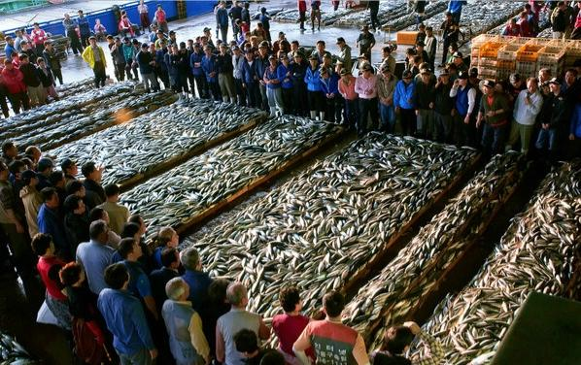
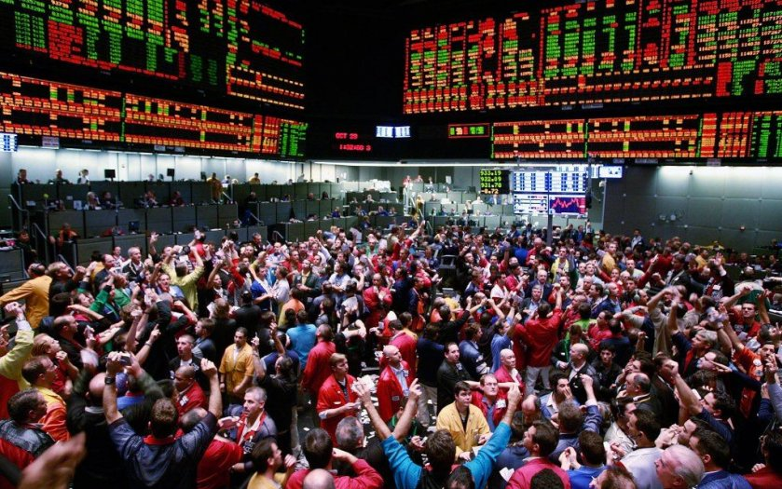
What is a market?
VS
Fish Market Auction
CME Outcry

Slide 6
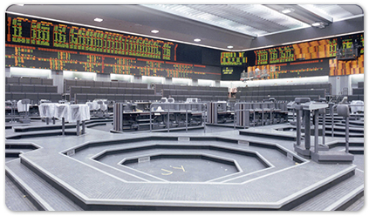
Stock Market in the past
The stock market used to have a well-defined physical presence, a trading floor
The New York Stock Exchange
The Tokyo Stock Exchange
The Korea Exchange
The London Stock Exchange
Most Futures Exchanges

Slide 7
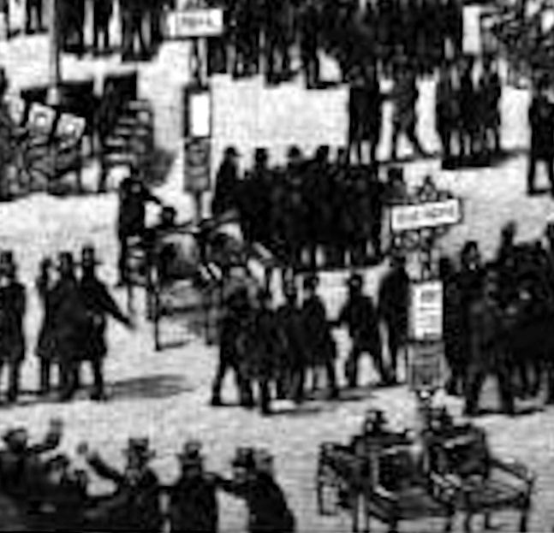
NYSE - 1872
First Trading posts look like ornate street signs
Transaction records are pegged to the front and back showing the current market price
Most posts are surrounded by four leader chairs

Slide 8
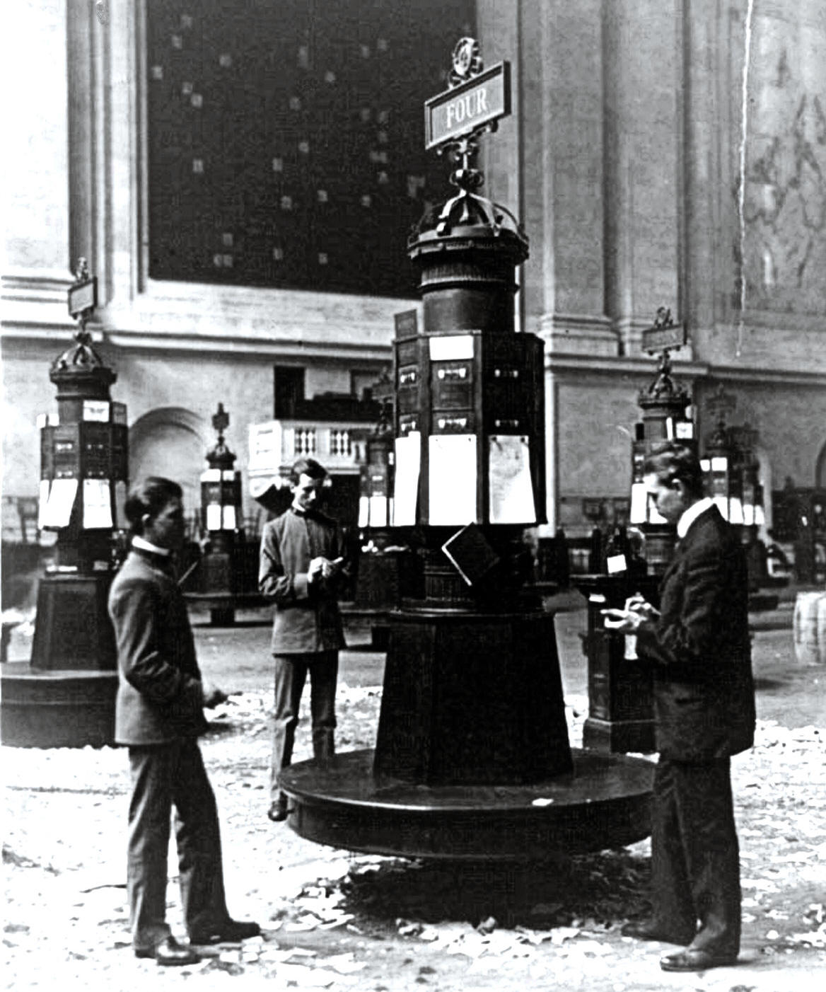
NYSE - 1903
The Exchange moved into its present building
Trading posts are numbered and have 16 price indicators

Slide 9
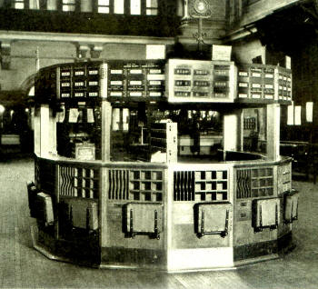
NYSE - 1928
The trading floor is expanded and telephones added to trading posts

Slide 10
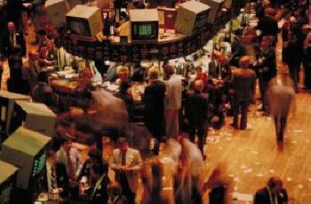
NYSE - 1978
Computer screens are installed atop each station
The Intermarket Trading System(ITS) provides an electronic link between the NYSE and other exchanges

Slide 11
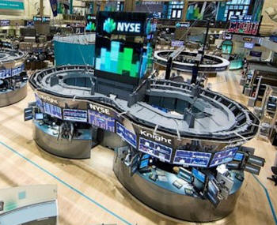
NYSE - 2011
Due to increased computer trading, there are fewer people on the exchange floor

Slide 12
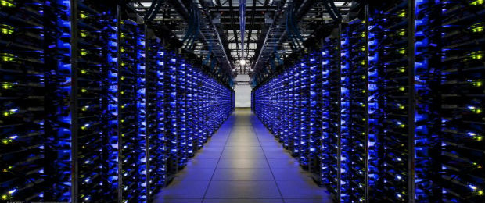
Stock Markets Today
The market is now a geographically dispersed network

Slide 13
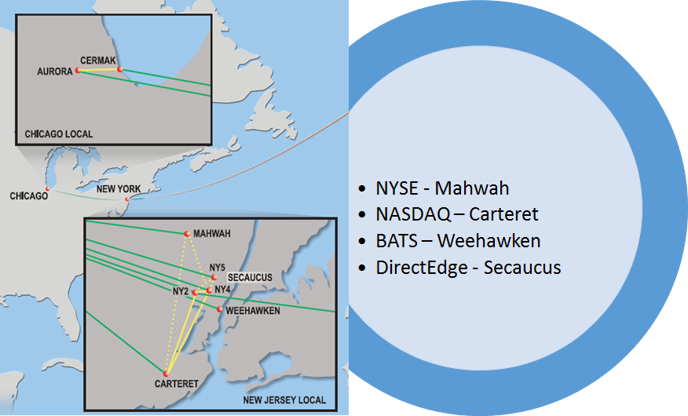
The U.S. Stock Market Center

Slide 14
The forces of technology, speed, and computer-based trading…
Have increasingly shaped the structure and behavior of markets
The evolution of the market
From human involvement to computer control
From operating in time frames of minutes to time scales of microseconds
Exchanges also act strategically
Choosing new pricing models (make-take fees)
Choosing market designs to attract particular volume to their trading venues

Slide 15
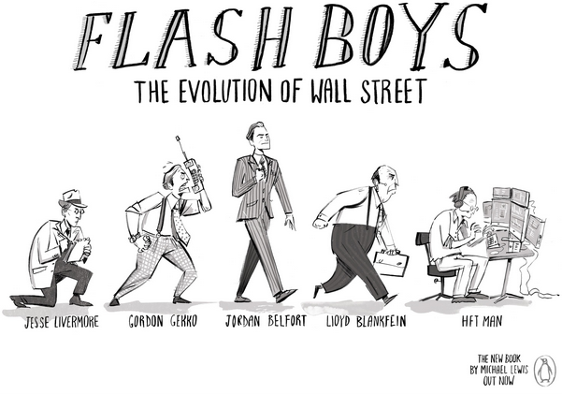
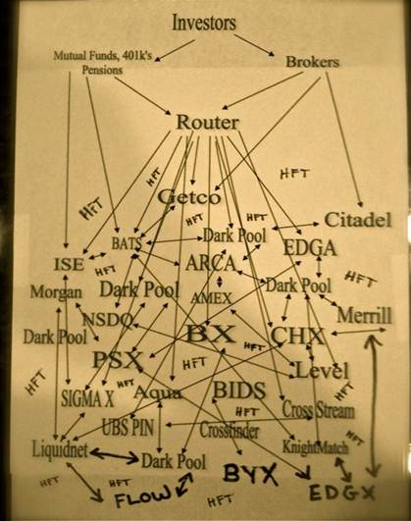
As a consequence,
High Frequency Trading
(Speed is Priced, New Pricing Rule)
Market Fragmentation
(New Competition and Trading Venues)

Slide 16
Trading Mechanism in Stock Markets
Client A
Client 1
Broker A
Broker C
Exchange
(NYSE)
Client B
Client 2
Client C
Client 3
Broker B
Broker D
Client D
Client 4
Client E
Client 5
Commission
Service Fee
Service Fee
Commission

Slide 17
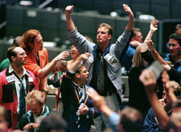
Traditional Trading Procedure
Customers
Broker
Phone
Internet Portal
Order Communicated to the Floor
Market (Exchange)
Old way of doing business

Slide 18
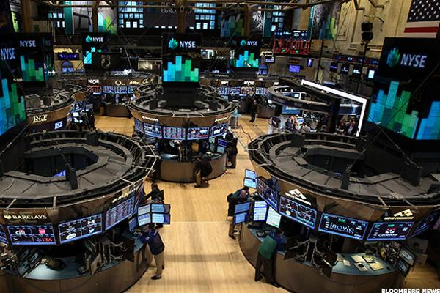
Electronic Market
Customers
Broker
Phone
Internet Portal
100% automatic execution algorithm interacting with order book
Market (Exchange)

Slide 19
Electronic execution model with API
Customers
Broker
Program-generated orders (API)
placeOrder(1,APPL,BUY,$100.25,200,…)
…
…
placeOrder(2,APPL,SELL,$105.25,100,…)
…
Algorithm execution
Market (Exchange)

Slide 20
Direct Market Access (DMA)
Customers
Broker
Client sends orders directly to the market
Client interacts directly with the market order book
Market (Exchange)

Slide 21
ECN, Dark Pools, Multiple Execution Venues
Customers
Broker
Smart Routing
: Algorithms look for the best venue to trade, in case more than one venue is available
NYSE
NASDAQ
BATS

Slide 22
High Frequency Trading
Proprietary traders who seek to profit from short-term trading activities
Virtu Financial, Jump Trading, Hudson River Trading, Tower Research Capital, Citadel
According to the Aite Group, HFT accounted for 73% of all equity trading volume in 2009
High Frequency Trading is a large and diverse set of activities and behaviors
HFT is done by computers
HFT relies on extreme technology to achieve speed
HFT is strategy-based
Being the first to hit a bid or lift an offer in response to some news event

Slide 23
HFT Technology
Colocation
Placing computers in the same room as the Exchange’s computers, so that all communication is at bus speeds (rather than network speeds)
Advanced computer technology
Fast solid-state disks
Fast logic circuits
Parallel computing using the GPU processor
Fast Communication links between citis
Microwave towers (See www.exaltcom.com)
Fast transoceanic fiber-optic cables

Slide 24
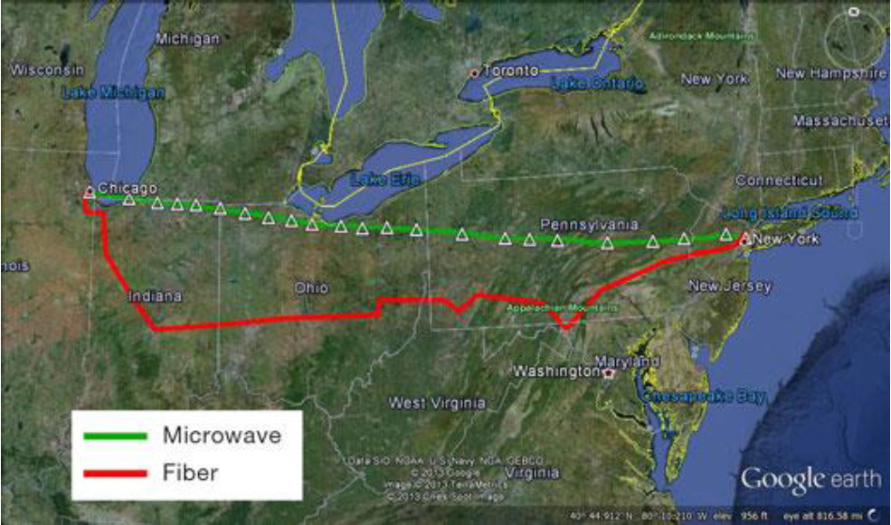
Microwave vs Fiber-optics (www.exaltcom.com)

Slide 25
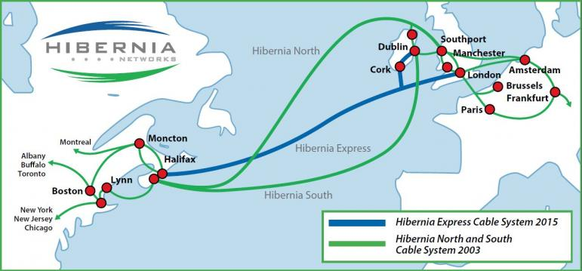
Hibernia Networks

Slide 26
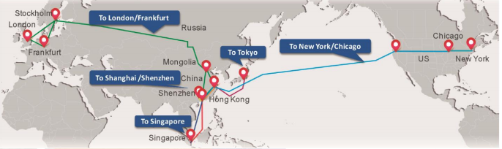
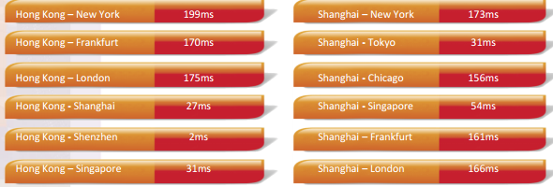
China Telecom – Ultra Low Latency

Slide 27
Ultra Low Latency
Latency is the time it takes to send data to a required end point
Milliseconds (1/1000), Microseconds (1/1 mill), Nanoseconds (1/1 bill)
Human eye : 400 ~500 milliseconds to respond to visual stimuli
Undersea cable by the Hibernia Express
London <-> New York (64.8 milliseconds -> 59.6 milliseconds)
Perseus Telecom’s new microwave network
London <-> Frankfurt (8.35 milliseconds -> 4.6 milliseconds)
New microchips -> sending trades in 740 nanoseconds
HFT pays huge fees to implement their trading strategies
They are still profitable

Slide 28
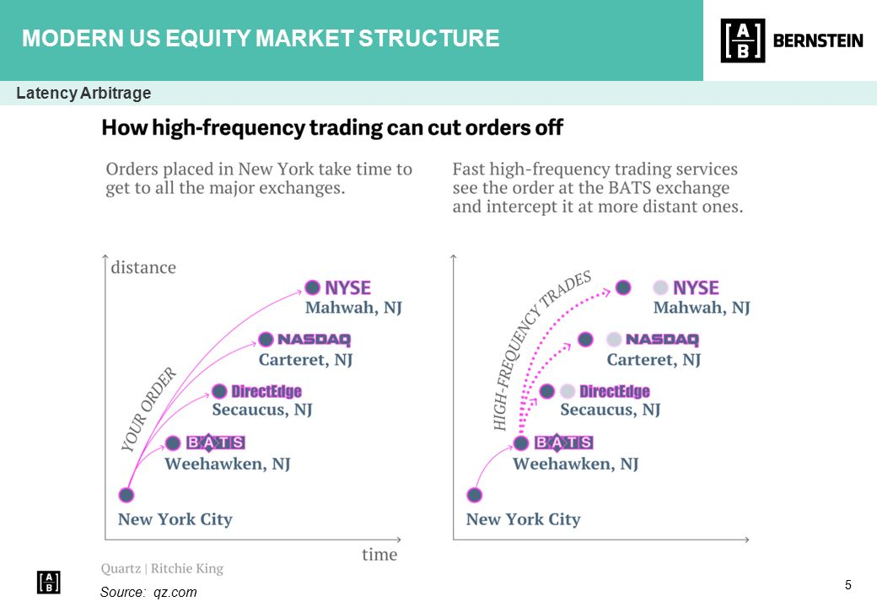
Low Latency Arbitrage

Slide 29
Market Fragmentation
In a fragmented market, trading occurs in multiple places or systems
The “home” for trading a stock is the issue’s primary listing exchange
The exchange provides trading facilities/procedures for the stock
The listing exchange does not have monopoly trading rights
Trading occurs in many venues, through many mechanisms
Current US and European markets
Are highly fragmented
US : More than 10 stock exchanges and more than 50 ATS
EU : Many trading places

Slide 30
Ordering and Routing in Fragmented Markets
Customer A
order
confirm
Brokerage Firm
Confirmation
Exchange
ATS /ECN
Dark Pool
Internalized
Order Executed

Slide 31
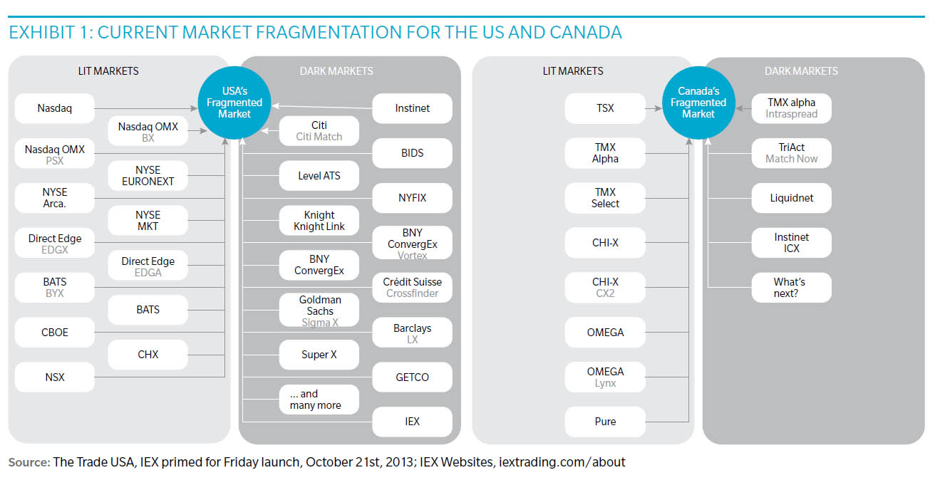

Slide 32
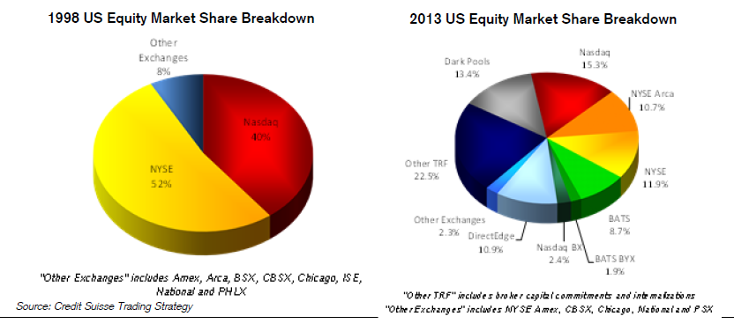
Fragmented Markets : U.S. Markets

Slide 33
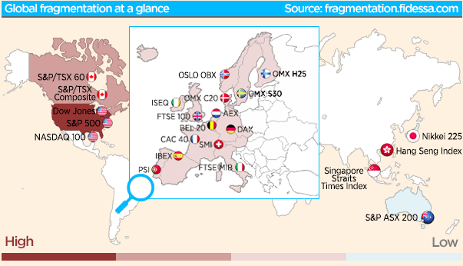
Global fragmentation

Slide 34
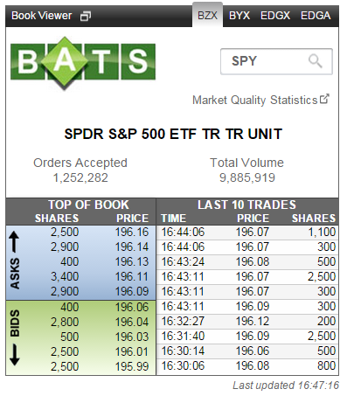
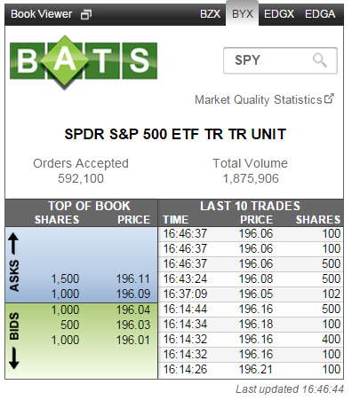
Routing Matters : BZX vs BYX

Slide 35
Fragmented Markets result in
Increase the price competition
Suppose you want to sell SPY stock : You want to receive better price !!
BATS X : The highest bid price is currently $196.06 with 400 shares
BATS Y : The highest bid price is currently $196.04 with 1,000 shares
You are expecting that your selling orders will be executed at 196.04 from BATS X
Unexpected events may occur
What if your broker sends yours orders to BATS Y -> You will receive worse price
What if your order sizes are greater than 400 shares -> Some of your orders are unexecuted and remained at BATS X
Brokers’ routing matters (Should we regulate them?)
Exchanges want to attract more orders so that they want to have more revenue
New trading venues (ATS, ECNs, Dark Pools)
New pricing schemes (Maker-taker pricing vs. Taker-maker pricing)

Slide 36
Virtual consolidation in fragmented markets
A fragmented market is difficult to use
Buyers and sellers must search for the best terms of trade
Your brokers will do but they still need to have consolidated information from multiple markets
To simplify the process, there are linking systems and procedures that aim to create virtual consolidation
Additional systems – routing costs
Some systems are mandated by regulation
U.S. : NMS rule
EU : MiFID 2007
Canada : UMIR
Australia : MIR

Slide 38

Is a competition beneficial to customers?

Slide 39
Korean Markets
Korean markets are currently a monopoly and consolidated (Not fragmented)
KRX (KOSPI + KOSDAQ + Futures)
No colocation service yet
But, there is a change
KRX will soon be listed (government institution -> profit –seeking firm)
KOSPI, KOSDAQ, and Futures Exchanges -> competition?
New ATSs will be introduced -> more competition

Slide 40




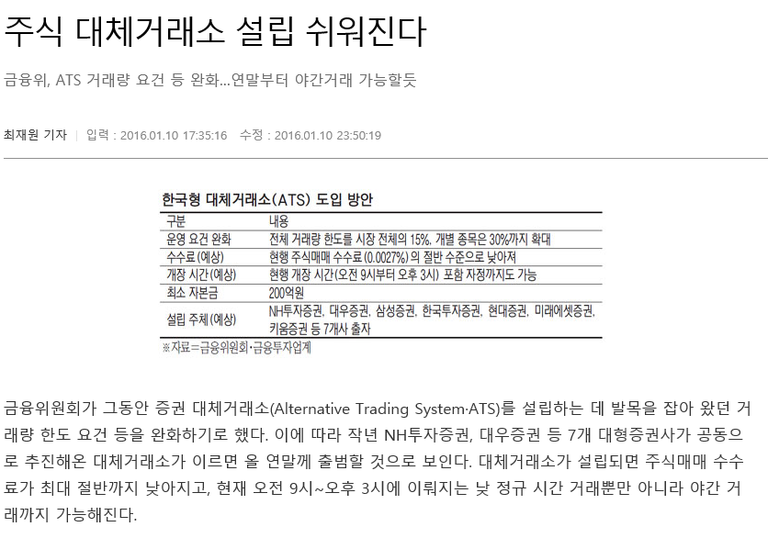




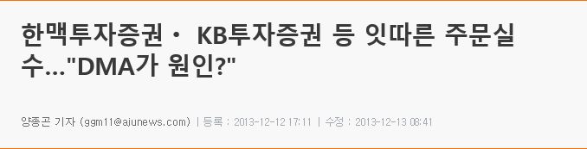

Slide 41
Summary
Markets are different now transformed by technology and HFT
With trading electronic, there is a wealth of trading data, and new data sets are becoming ever more available
Data sets are expensive to purchase, store, and manipulate
These changes requires more research
Do HFTs improve market quality?
Is market fragmentation good for investors?
How do specific trading strategies affect market performance?
How should markets be designed?
What activities should regulation allow?
How has market quality fared in this new environment?
Whether society enhanced by such an arms race in technology?
Is there a better way to link markets?

